Slide 1
Unit 3
AIX 6.1 Documentation

Slide 2
Unit Objectives
After completing this unit, you should be able to:
Use the man command to view information about AIX commands
Describe the use of AIX 6.1 Web-based online documentation

Slide 3
man Command
The man command provides reference information on commands, subroutines, and files
Manual information consists of:
  Purpose (one line description)
  Syntax (all valid options and arguments)
  Description (verbose description)
  Flags (description of all valid options)
  Examples (command examples)
  Files (associated files and directories)
  Related Information (additional resources and information)

Slide 4
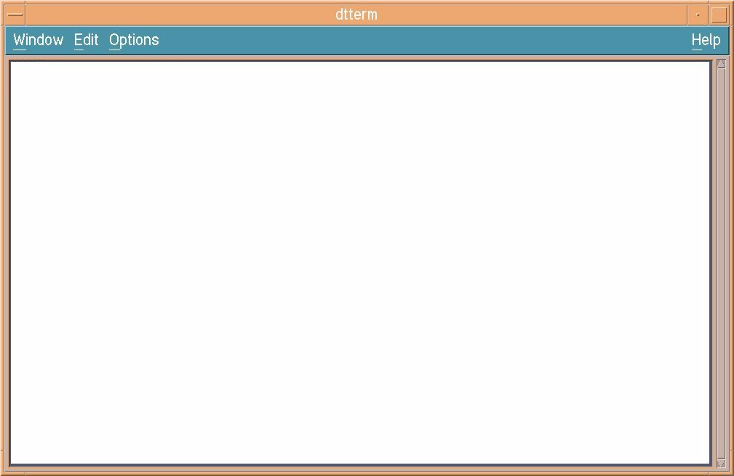
man Example
$ man who
Purpose
Identifies the users currently logged in.
Syntax
who [ -a | -b -d -h -i -I -m -p -q -u -H -T ] [ File ]
who am { i | I}
Description
The who command displays information about all users currently on the
local system. The following information is displayed: login name,
workstation name, date and time of login.
Flags
-m Displays information about the current terminal. The
who -m command is equivalent to the who am i and
who am I commands.
-u or -i Displays the user name, workstation name, login time,
line activity, and process ID of each current user.
Examples
1. To display information about who is using the local system node,
enter:
who
Implementation Specifics
This command is part of Asynchronous Terminal Emulation (ATE)
Files
/etc/utmp Contains user and accounting information.

Slide 5
man -k: Working with a Keyword
The -k option of the man command allows you to print out one line descriptions of all entries which match the given keyword
Example:
$ man -k print
cancel(1) Cancels requests to a line printer
disable(1) Disables a printer queue device
enable(1) Enables a printer queue device
lpr(1) Enqueues print jobs
lpstat(1) Displays line printer status information
qcan(1) Cancels a print job
qchk(1) Displays the status of a print queue

Slide 6


Viewing AIX 6.1 Documentation
Documentation Server
  AIX 6.1 softcopy documentation
  AIX Information Center
  Web browser software
Documentation Client
  Web browser software
Documentation Client
  Web browser software
View AIX 6.1 documentation
from anywhere with a browser
IBM
http://publib.boulder.ibm.com/infocenter/pseries/v6r1/index.jsp

Slide 7
Accessing the Documents from a Web Browser
Mozilla Firefox for AIX
  New features, supports many current Web standards
  64-bit
  Available as a Web download or on CD when ordering AIX
  (Mozilla Firefox for AIX CD)
Mozilla
  Standard browser beginning with AIX 5L 5.3
  Supports all versions of AIX 5L
  32-bit
  Available as a Web download
http://www.ibm.com/servers/aix/browsers

Slide 8
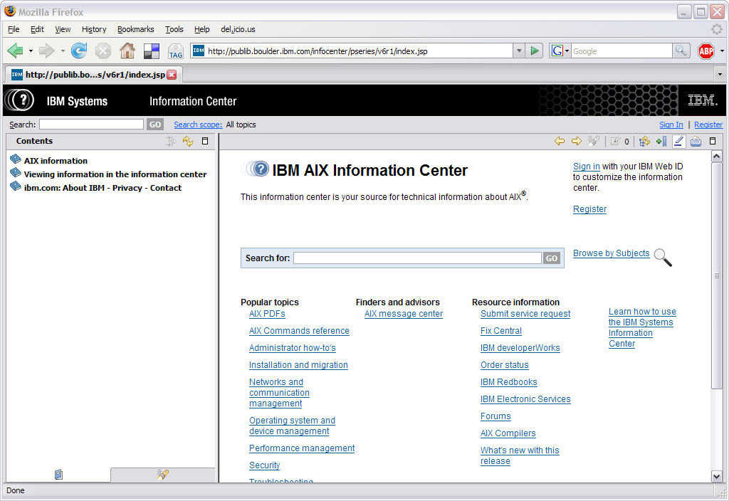
AIX 6.1 Documentation

Slide 9
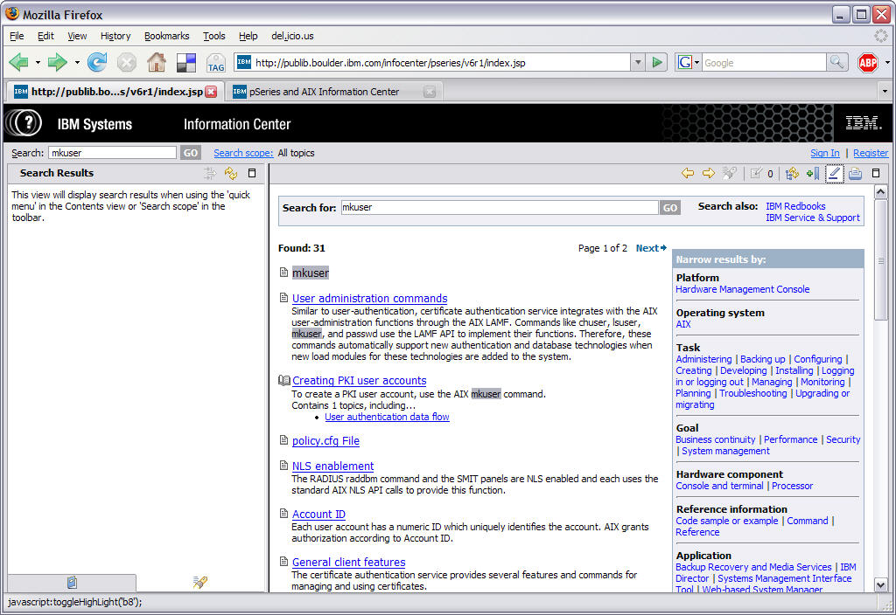
Search AIX 6.1 Documentation

Slide 10
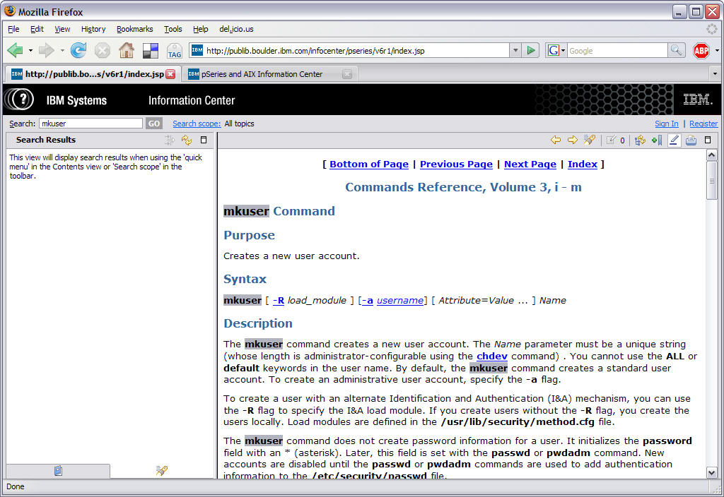
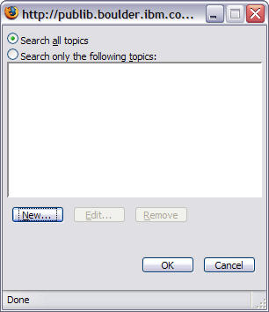
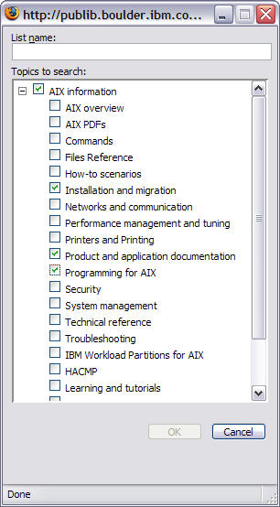
Search Scope

Slide 11
Checkpoint
Which command displays manual entries online?
Complete the following sentences:
The AIX 6.1 online documentation is loaded on a
_________ _______. Any other computer in the network with appropriate Web browser software can then become a _________ ______.
How can you start the documentation from the command line?

Slide 12
Checkpoint Solutions
Which command displays manual entries online? man
Complete the following sentences:
The AIX 6.1 online documentation is loaded on a document server. Any other computer in the network with appropriate Web browser software can then become a document client.
How can you start the documentation from the command line? infocenter

Slide 13

Exercise: AIX 6.1 Documentation

Slide 14
Unit Summary
The man command can be used from the command line to view descriptions of AIX commands.
Use a Web browser to access online documentation with
AIX 6.1.
The online documentation and System p InfoCenter use the same interface.

